Slide 1
Derivatives of Exponential and Inverse Trig Functions
Objective: To derive and use formulas for exponential and Inverse Trig Functions

Slide 2
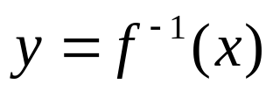

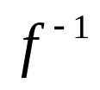

Differentiability
Geometrically, a function is differentiable at those points where its graph has a nonvertical tangent line. Since the graph of
is the reflection of the graph of about
the line y = x, it follows that the points where
is not differentiable are reflections of the points where the graph of f has a horizontal tangent line. Algebraically, will fail to be differentiable at a point (b, a) if

Slide 3
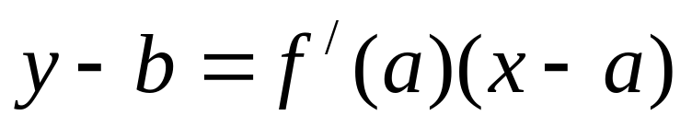
Differentiability
We know that the equation of the tangent line to the graph of f at the point (a, b) is

Slide 4
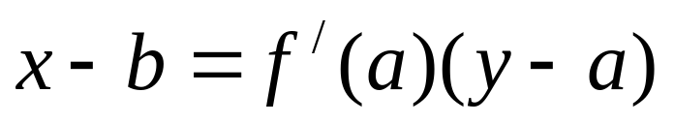
Differentiability
We know that the equation of the tangent line to the graph of f at the point (a, b) is
To find the reflection on the line y = x we switch the x and the y, so it follows that the tangent line to the graph of at the point (b, a) is

Slide 5
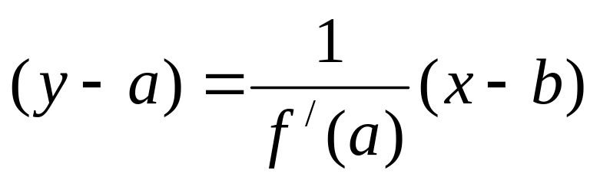
Differentiability
We will rewrite this equation to make it

Slide 6
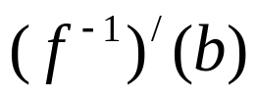
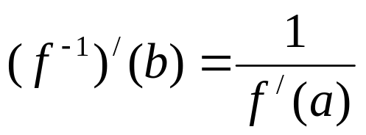
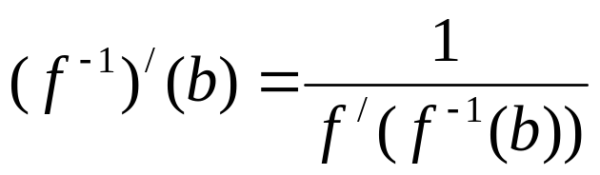

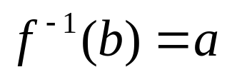
Differentiability
We will rewrite this equation to make it
This equation tells us that the slope
of the tangent line to the graph of at (b, a) is
or
If then

Slide 7
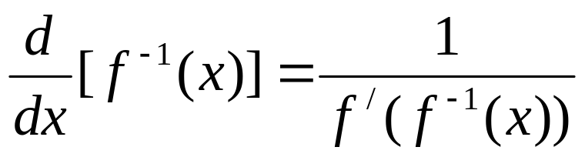
Theorem 3.3.1
The derivative of the inverse function of f is defined as:

Slide 8
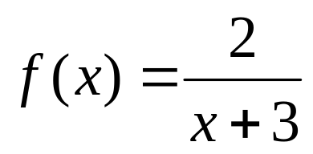
Example
Find the derivative of the inverse for the following function.

Slide 9
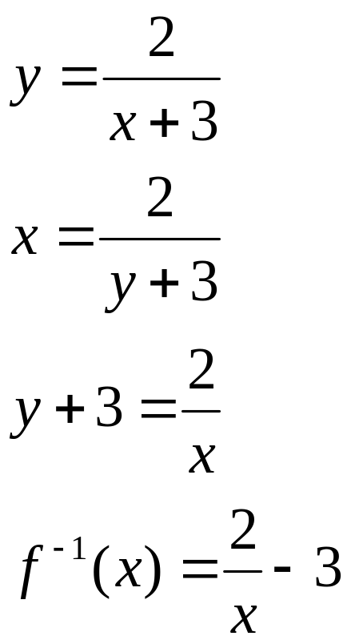
Example
Find the derivative of the inverse for the following function.

Slide 10
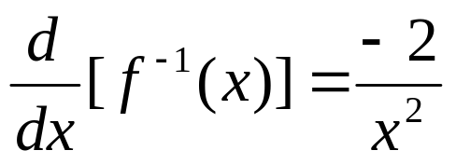
Example
Find the derivative of the inverse for the following function.

Slide 11
Example
Find the derivative of the inverse for the following function.

Slide 12
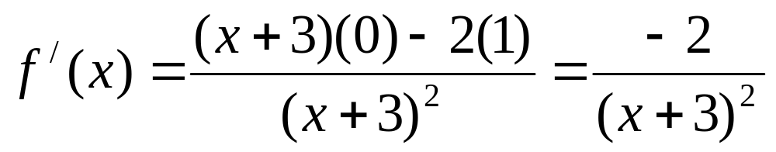
Example
Find the derivative of the inverse for the following function.

Slide 13
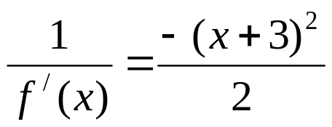
Example
Find the derivative of the inverse for the following function.

Slide 14
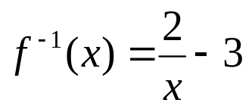
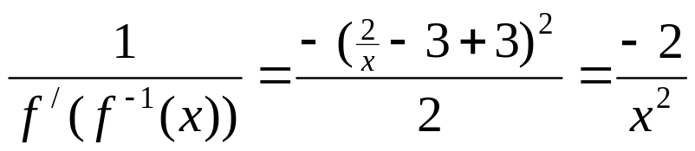
Example
Find the derivative of the inverse for the following function.

Slide 15

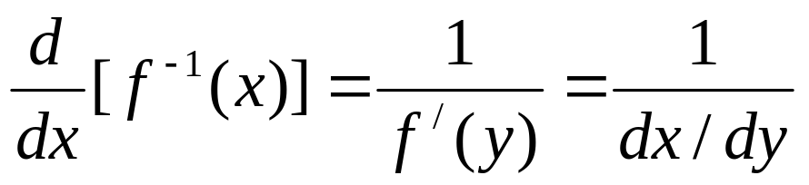
Theorem 3.3.1
The derivative of the inverse function of f is defined as:
We can state this another way if we let
then

Slide 16
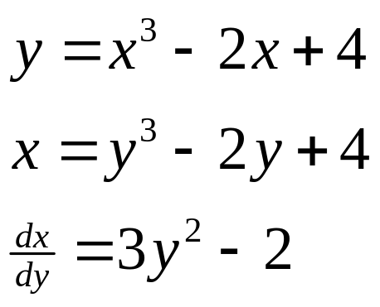
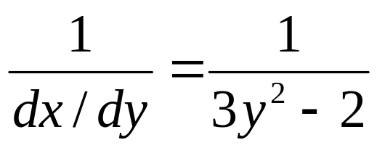
Theorem 3.3.1
We can state this another way if we let
then

Slide 17
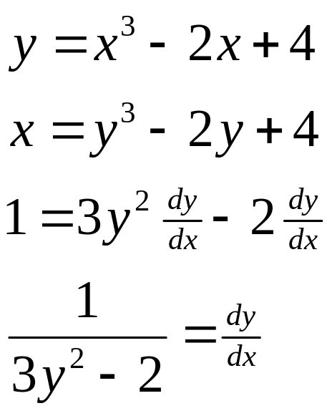
Theorem 3.3.1
We can state this another way if we let
then

Slide 18
One-to-One
We know that a graph is the graph of a function if it passes the vertical line test.
We also know that the inverse is a function if the original function passes the horizontal line test.

Slide 19
One-to-One
We know that a graph is the graph of a function if it passes the vertical line test.
We also know that the inverse is a function if the original function passes the horizontal line test.
If both of these conditions are satisfied, we say that the function is one-to-one. In other words, for every y there is only one x and for every x there is only one y.

Slide 20
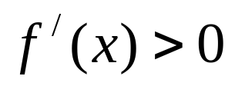
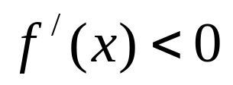
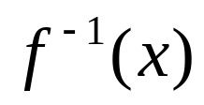
Increasing/Decreasing
If a function is always increasing or always decreasing, it will be a one-to-one function.
Theorem 3.3.2 Suppose that the domain of a function f is an open interval I on which
or on which . Then f is one-to-one,
is differentiable at all values of x in the range of f and the derivative is given by

Slide 21
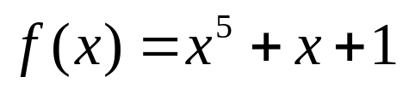
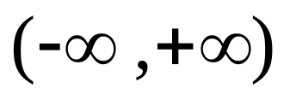
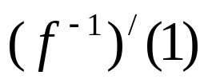
Example 2
Consider the function .
Show that f is one-to-one.
Show that is differentiable on the interval
Find a formula for the derivative of .
Compute .

Slide 22
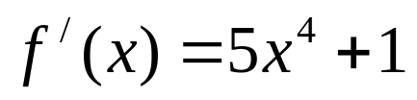
Example 2
Consider the function .
Show that f is one-to-one.
which is always positive, so the function is one-to-one.

Slide 23
Example 2
Consider the function .
Show that f is one-to-one.
Show that is differentiable on the interval
Since the range of f is , this is the domain of and from Theorem 3.3.2 is differentiable at all values of the range of f .

Slide 24
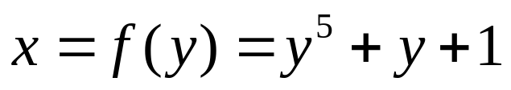
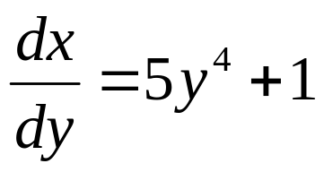
Example 2
Consider the function .
Show that f is one-to-one.
Show that is differentiable on the interval
Find a formula for the derivative of .

Slide 25
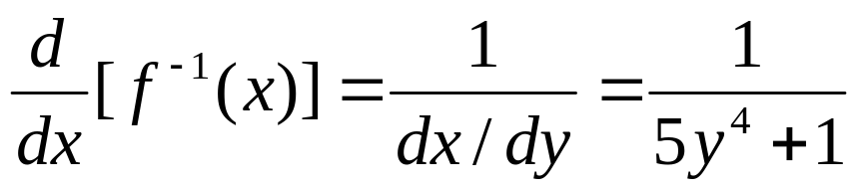
Example 2
Consider the function .
Show that f is one-to-one.
Show that is differentiable on the interval
Find a formula for the derivative of .

Slide 26
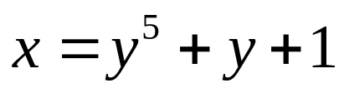
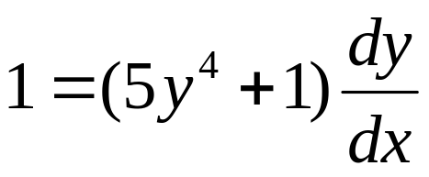
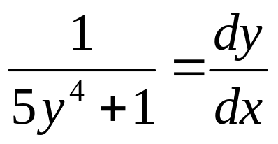
Implicit
Using implicit differentiation, we get

Slide 27
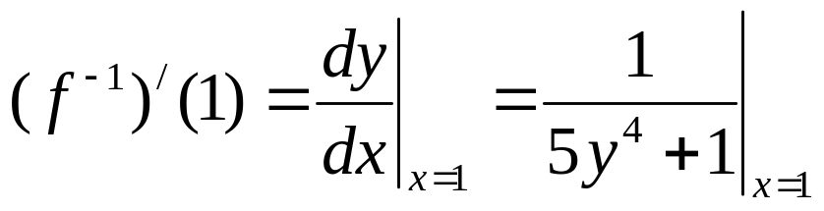
Example 2
Consider the function .
Show that f is one-to-one.
Show that is differentiable on the interval
Find a formula for .
Compute

Slide 28
Example 2
Consider the function .
Show that f is one-to-one.
Show that is differentiable on the interval
Find a formula for .
Compute
Since (0, 1) is a point on the function, the point (1, 0) is on the inverse function.

Slide 29
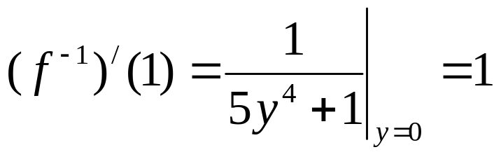
Example 2
Consider the function .
Show that f is one-to-one.
Show that is differentiable on the interval
Find a formula for .
Compute
Since (0, 1) is a point on the function, the point (1, 0) is on the inverse function.

Slide 30
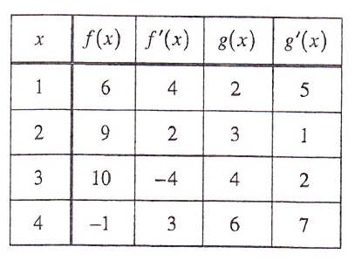
Example 2A
This is how we will use the other equation.
If f ⁻¹ is the inverse of f, write an equation of the tangent line to the graph of y = f ⁻¹(x) at x = 6.

Slide 31
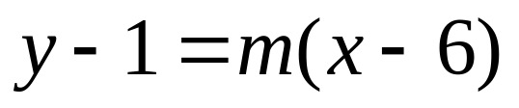
Example 2A
This is how we will use the other equation.
If f ⁻¹ is the inverse of f, write an equation of the tangent line to the graph of y = f ⁻¹(x) at x = 6.
If f(1) = 6, f ⁻¹(6) = 1.

Slide 32
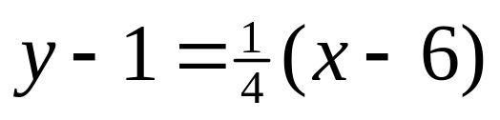
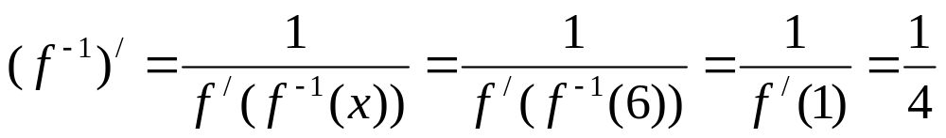
Example 2A
This is how we will use the other equation.
If f ⁻¹ is the inverse of f, write an equation of the tangent line to the graph of y = f ⁻¹(x) at x = 6.
If f(1) = 6, f ⁻¹(6) = 1.

Slide 33
You Try
This is how we will use the other equation.
If f ⁻¹ is the inverse of f, write an equation of the tangent line to the graph of y = f ⁻¹(x) at x = 9.

Slide 34
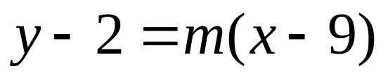
Example 2A
This is how we will use the other equation.
If f ⁻¹ is the inverse of f, write an equation of the tangent line to the graph of y = f ⁻¹(x) at x = 9.
If f(2) = 9, f ⁻¹(9) = 2.

Slide 35
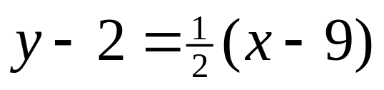
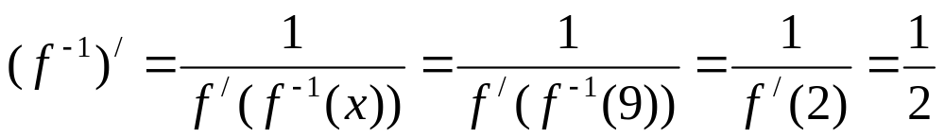
Example 2A
This is how we will use the other equation.
If f ⁻¹ is the inverse of f, write an equation of the tangent line to the graph of y = f ⁻¹(x) at x = 9.
If f(2) = 9, f ⁻¹(9) = 2.

Slide 36
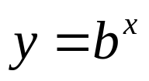
Derivatives of Exponential Functions
We will use our knowledge of logs to find the derivative of . We are looking for dy/dx.

Slide 37
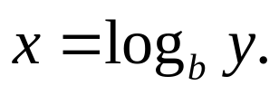
Derivatives of Exponential Functions
We will use our knowledge of logs to find the derivative of . We are looking for dy/dx.
We know that is the same as

Slide 38
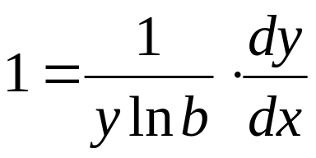
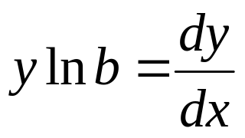
Derivatives of Exponential Functions
We will use our knowledge of logs to find the derivative of . We are looking for dy/dx.
We know that is the same as
We will take the derivative with respect to x and simplify.

Slide 39
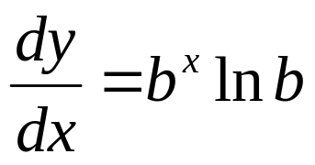
Derivatives of Exponential Functions
We will use our knowledge of logs to find the derivative of . We are looking for dy/dx.
We know that is the same as
We will take the derivative with respect to x and simplify.
Remember that so

Slide 40
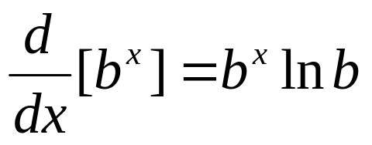
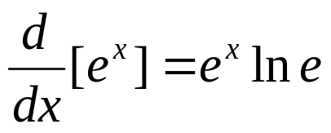


Derivatives of Exponential Functions
This formula, works with any
base, so if the base is e, it becomes
but remember , so

Slide 41


Derivatives of Exponential Functions
With the chain rule these formulas become:

Slide 42

Example 3
Find the following derivatives:

Slide 43

Example 3
Find the following derivatives:

Slide 44

Example 3
Find the following derivatives:

Slide 45

Example 3
Find the following derivatives:

Slide 46

Example 3
Find the following derivatives:

Slide 47

Example 3
Find the following derivatives:

Slide 48

Example 3
Find the following derivatives:

Slide 49

Example 3
Find the following derivatives:

Slide 50

Example 4
Use logarithmic differentiation to find

Slide 51

Example 4
Use logarithmic differentiation to find
Let

Slide 52

Example 4
Use logarithmic differentiation to find
Let

Slide 53

Example 4
Use logarithmic differentiation to find
Let

Slide 54

Example 4
Use logarithmic differentiation to find

Slide 55

Example 4
Use logarithmic differentiation to find

Slide 56

Derivatives of Inverse Trig Functions
We want to find the derivative of

Slide 57

Derivatives of Inverse Trig Functions
We want to find the derivative of
We will rewrite this as and take the derivative.

Slide 58

Derivatives of Inverse Trig Functions
We want to find the derivative of
We will rewrite this as and take the derivative.

Slide 59

Derivatives of Inverse Trig Functions
We want to find the derivative of
We will rewrite this as and take the derivative.

Slide 60

Derivatives of Inverse Trig Functions
We want to find the derivative of
We will rewrite this as and take the derivative.

Slide 61


Derivatives of Inverse Trig Functions
We need to simplify
We will construct a triangle to help us do that. Remember that represents an angle θ where sin θ = x.

Slide 62


Derivatives of Inverse Trig Functions
We need to simplify
The cosine is the adjacent over the hypotenuse.

Slide 63

Special Triangle
Find

Slide 64


Special Triangle
Find
Again, we will construct a triangle where the cos θ = x to help solve this problem.

Slide 65






Derivatives of Inverse Trig Functions

Slide 66


Example 5
Find dy/dx if:

Slide 67


Example 5
Find dy/dx if:

Slide 68


Example 5
Find dy/dx if:

Slide 69
Homework
Section 3.3
Pages 201-202
1, 5, 7, 9
15-27 odd
37-51 odd

